Slide 1
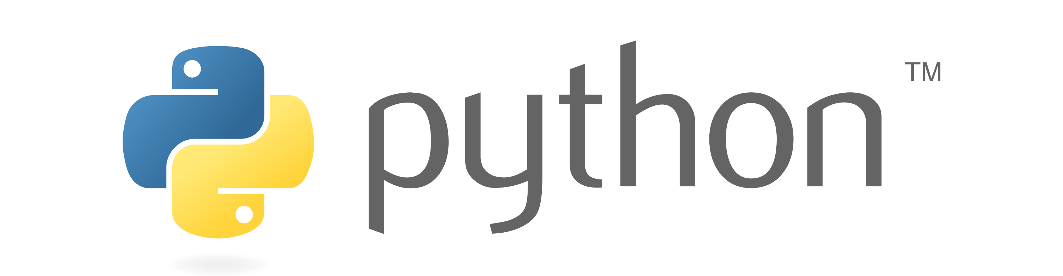

Slide 2

Multitasking
Executing multiple task at the same time.
In this picture you can see that one mother is doing multiple task at a same time.
1. Answering the call
2. Handeling the baby
3. Cooking food
4. Checking mail
5. Thinking about shoping

Slide 3
Type of Multitasking
Process based Multitasking
Thread based Multitasking

Slide 4
Process Based Multitasking
Executing multiple task at the same time where each task is a separate independent program(process), is called process based multitasking. It is suitable for Operating System level.
e.x suppose we are downloading a file and at the same time watching a movie so both are independent process based task.

Slide 5
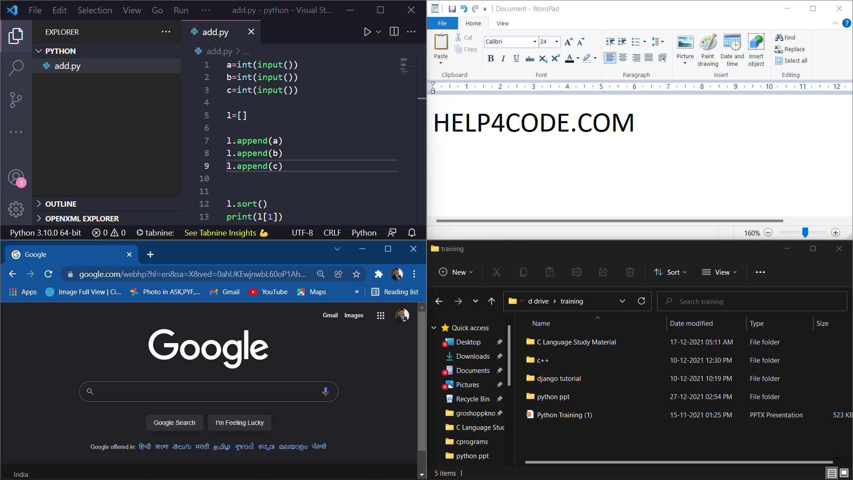

Slide 6
Thread Based Multitasking
Executing multiple task at the same time where each task is a separate independent part of the same program(process), is called Thread based multitasking and each independent part is called Thread. It is suitable for Programmatic level.
Ex: - MS Word
suppose we have 20000 line of code and after observing code we realize that first 10000 line of code executing different task and another 10000 line of code executing other task but both are independent part of same program so here thread based is possible.

Slide 7
Process Based Multi Tasking | Thread Base Multi Tasking
Here the program is a smallest unit that executed independently | Here thread is a smallest unit that will be executed independently
Process based tasking executing heavy task that’s why it takes separate address | Thread based executing light weight task that’s why it takes less space share the same memory area with other thread also.
Here inter process communication are heavy | Here thread based communication are not heavy
Here switching from one process to another process is heavy time consuming | Here switching from one thread to another are not time consuming because it share the same memory area
It is fit for OS level Memory: here each process have its own memory ,program counter, data section, stack and register set. | It is fit for programmatic level Memory: here each thread has its own program counter, stack and register set but it share same memory address.

Slide 8
What is Thread
Thread is a separate flow of execution. Every thread has a task.
Here thread is a smallest unit that can be executed simultaneously.

Slide 9
1. Answering the call
2. Handeling the baby
3. Cooking food
4. Checking mail
5. Thinking about shoping

Slide 10
Multithreading
Using Multiple Threads in program or process
The main important application areas of multi threading are:
Multimedia Graphic
Animations
Video Games
Web Servers
Application Servers

Slide 11





Slide 12
Main Thread
When we start any Python Program, one thread begins running immediately, which is called Main Thread of that program created by PVM.
The main thread is created automatically when your program is started.
import threading
t = threading.current_thread().getName()
print(t)

Slide 13
Creating a Thread
Thread class of threading module is used to create threads. To create our own thread we need to create an object of Thread Class.
Following are the ways of creating threads:-
Creating a thread without using a class
Creating a thread by creating a child class to Thread class
Creating a thread without creating child class to Thread class

Slide 14
Creating a thread without using a class
from threading import Thread
thread_object = Thread(target=function_name, args=(arg1, arg2, …))
thread_object – It represents our thread.
target – It represents the function on which the thread will act.
args – It represents a tuple of arguments which are passed to the function.
Ex:-
t = Thread(target=disp, args=(10,20))

Slide 15
How to Start Thread
Once a thread is created it should be started by calling start() Method.
from threading import Thread
def disp(a, b):
print(“Thread Running:”, a, b)
t = Thread(target=disp, args=(10, 20))
t.start()
from threading import Thread
def disp(a, b):
print(“Thread Running:”, a, b)
for i in range(5):
t = Thread(target=disp, args=(10, 20))
t.start()
Starting Thread
Starting Thread

Slide 16
from threading import Thread
def disp():
for i in range(5):
print(“Child Thread”)
t = Thread(target=disp)
# upto here there is only one thread – Main Thread
# All the above code executed within Main Thread
t.start()
# Once we start Child thread, there are now Two Threads – Main Thread and Thread-1
# Child Thread is responsible to run disp method
# and below code will be run by Main thread
for i in range(5):
print(“Main Thread”)
Main thread is responsible to create and Start Child Thread, once the child thread has started both the thread behave separately.

Slide 17
Set and Get Thread Name
current_thread() – This function return current thread object.
getName() – Every thread has a name by default, to get the name of thread we can use this method.
setName(name) – This method is used to set the name of thread.
name Property – This property is used to get or set name of the thread.
Ex:-
thread_object.name = ‘String’
print(thread_object.name)

Slide 18
Creating a thread by creating a child class to Thread class
We can create our own thread child class by inheriting Thread Class from threading module.
class ChildClassName(Thread):
statements
Thread_object = ChildClassName ()
Ex:-
class Mythread(Thread):
pass
t = Mythread()

Slide 19
Thread Class’s Methods
start ( ) – Once a thread is created it should be started by calling start() Method.
run( ) – Every thread will run this method when thread is started. We can override this method and write our own code as body of the method. A thread will terminate automatically when it comes out of the run( ) Method.
join ( ) – This method is used to wait till the thread completely executes the run ( ) method.

Slide 20
Thread Child Class with Constructor
from threading import *
Class Mythread(Thread):
def __init__(self, a):
Thread.__init__(self)
self.a = a
t = Mythread(10)
Thread Class as Parent Class
Calling Thread Class Constructor

Slide 21
Creating a thread w/o creating a child class to Thread class
We can create an independent thread child class that does not inherit from Thread Class from threading module.
class ClassName:
statements
object_name = ClassName ()
Thread_object = Thread(target=object_name.function_name, args=(arg1, arg2,…))
Ex:-
class Mythread:
def disp (self, a, b): print(a, b)
myt = Mythread()
t = Thread(target=myt.disp, args=(10, 20))
t.start()

Slide 22
Single Tasking using a Thread
When multiple tasks are executed by a thread one by one, then it called single tasking.
Writing Examination
Question 1
Question 2
Question 3

Slide 23
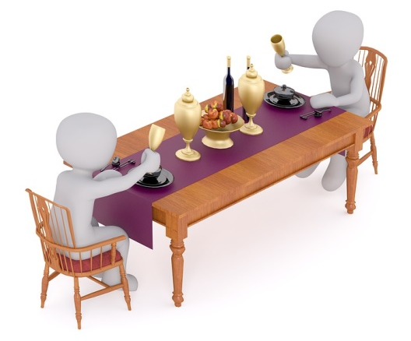



Multitasking using Multiple Thread
When multiple tasks are executed at a time, then it is called Multi-tasking. For this purpose we need more than one thread and when we use more than one thread, it is called multi threading.

Slide 24

Multitasking using a Multiple Thread
When multiple tasks are executed at a time, then it is called Multi-tasking. For this purpose we need more than one thread and when we use more than one thread, it is called multi threading.

Slide 25
Race Condition
Race condition is a situation that occurs when threads are acting in an unexpected sequence, thus leading to unreliable output.
This can be eliminated using thread synchronization.

Slide 26
Thread Identification Number
Every thread has an unique identification number which can be accessed using variable ident.
Syntax:- Thread_object.ident
Ex:- t.ident

